Slide 1

Analyzing NYSE DATA
Abdullah Aldossari

Slide 2
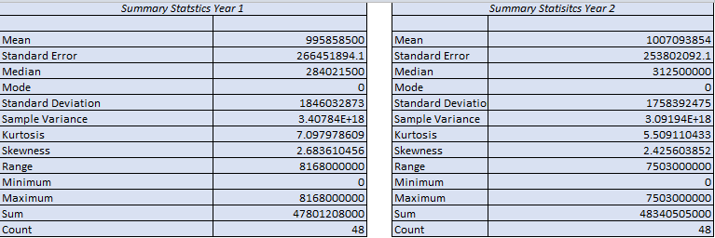
Summary Statistics How Much Does The Health Care Sector Spend on Research and Development in Year 1 and Year 2 ?
The Following tables are summary statistics for the HealthCare Sector Spending on R&D. We can see the difference in the mean from year 1 and year. The Spending on R&D in Year 2 is slightly higher from Year 1 . The mean for Research and Development in the first year is $980 million and in the second year it increased to $1 billion. Moreover, the median for the first year is $312 million and the first is $284 million. The standard deviation for the first year is $184 million and the second year is $175 million, which means that the healthcare is spending more in Healthcare Research and Development.

Slide 3
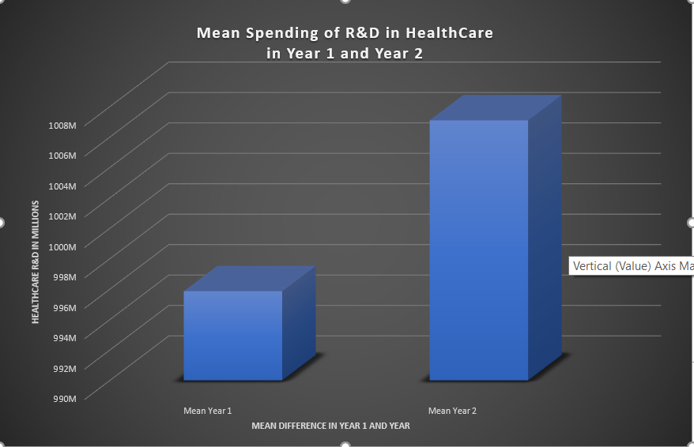
Summary Statistics
The graph show that research and development mean in the second year is slightly higher by more the $110 million, which means that the healthcare sector is investing more in R&D.

